Slide 1
Van Gogh’s Night
By: Younggyun Kim
Justin Kim

Slide 2
Biography
Vincent Willem Van Gogh
is the artist we chose.
The historical period he worked during is the post impressionist period.
He was born on March 30, 1853 and
died on July 29, 1890.

Slide 3
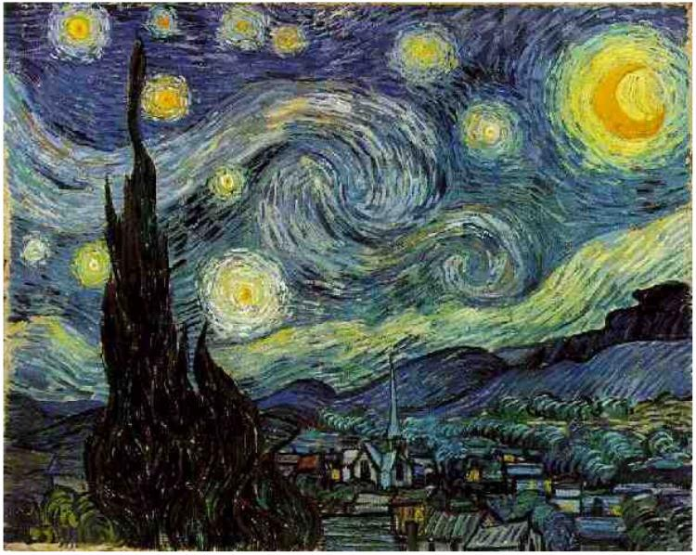
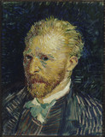
Arts by Van Gogh
Starry Night 1889
Used slight brushstrokes
Oil on Canvas
Self Portrait 1887
Used slight brushstrokes
Oil on Canvas

Slide 4
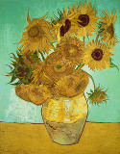
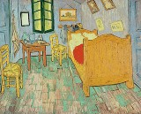
Arts by Van Gogh
Van Gogh’s bedroom 1889
Oil on canvas
Sunflowers 1888
Oil on canvas

Slide 5
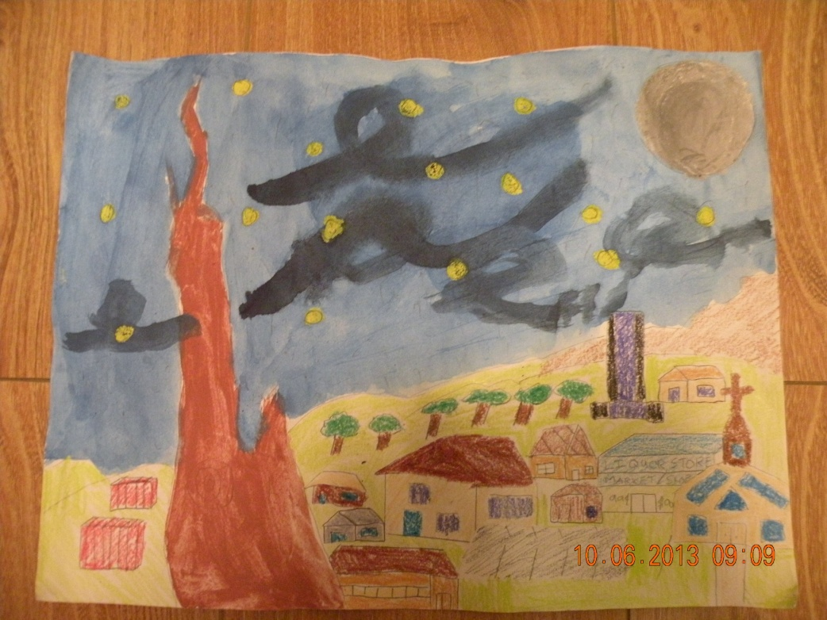
Snowy Night
The creative techniques I used were brushstrokes and depth. I got inspired by my mom.
10/6/13
Justin Kim

Slide 6
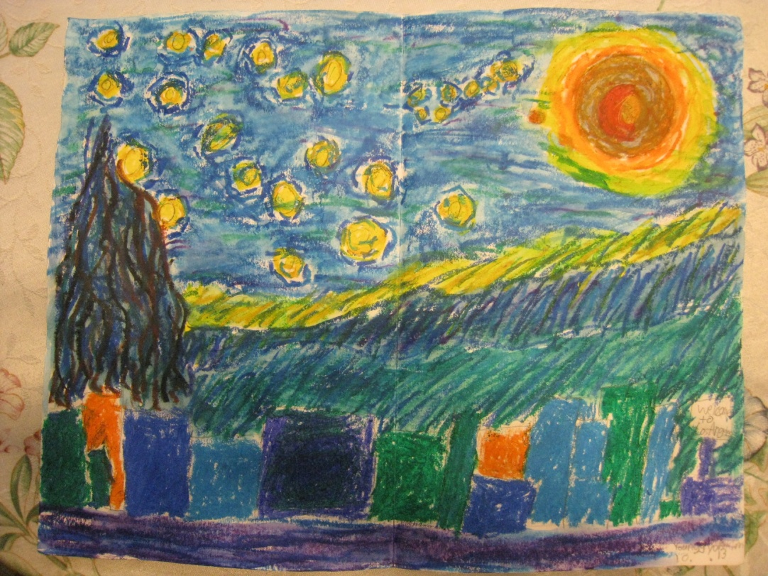
Night of Los Angeles
I used slight brushstrokes to make wind like illusion.
This art shows the night of LA itself.
I chose Van Gogh’s art because he showed passion and love in to his art. 10/6/13
Young Gyun Kim

